Slide 2
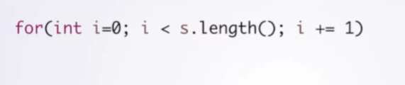
For loop
Note that i increment only occurs after execution

Slide 3
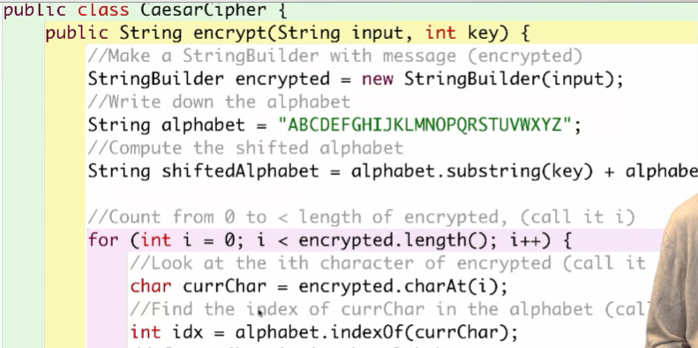
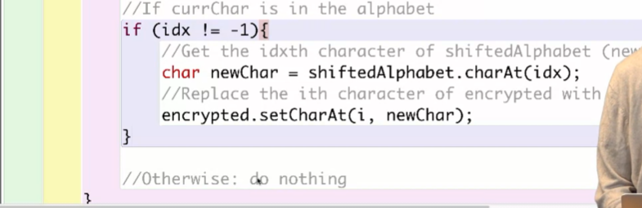
Sample code for ccaesarcipher

Slide 4
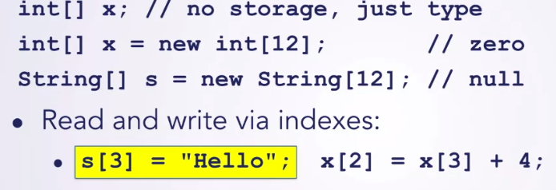
Array
Homogenous (same) collection

Slide 5
Class
Class name = Noun (e.g. car)
Method name = Verb (describe action. E.g. accelerate )
Field name
Noun (things that a class has)
Djective describe properties

Slide 6
Visibility (public vs private vs static)
Public : specify how to access class, method and field
The access level is everywhere: inside/outside a class, inside/outside a package
Private: The access level is only inside the class
Static: we can access fields/methods directly using the class name (without creating new instance)

Slide 7
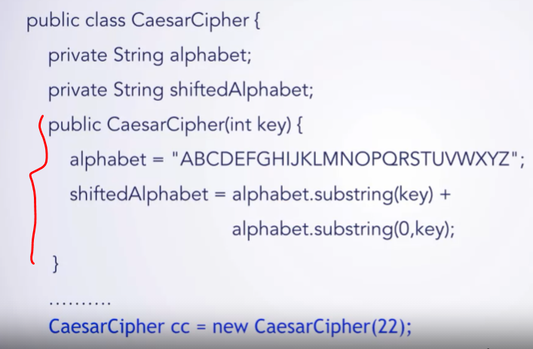
constructors
Initialize the fields on the object

